Slide 1
Network Architectures
A simplified view …

Slide 2
Disclaimer
The purpose of this session is NOT to make you network engineers
We will look briefly at networks, structures of networks and a little bit at protocols
The goal is mainly to give you an overview, with enough understanding to comprehend how it affects architecture and design

Slide 3
The story so far …
We have looked at computers, Operating Systems and Applications
We have looked at how applications talk to each other … on the same computer
In the 1970s it became apparent that it would be useful to have computers talk to each other
At first, just sending data with an approach to sharing information, especially between researchers
This evolved to having applications communicate data
And so, networks were born …

Slide 4
History (condensed)
Year | Event
1961 | The idea of ARPANET, one of the earliest computer networks, was proposed by Leonard Kleinrock in 1961, in his paper titled "Information Flow in Large Communication Nets."
1969 | ARPANET was one of the first computer networks to use packet switching. Development of ARPANET started in 1966, and the first two nodes, UCLA and SRI (Standford Research Institute), were connected, officially starting ARPANET in 1969.
1969 | The first RFC surfaced in April 1969, as a document to define and provide information about computer communications, network protocols, and procedures.
1969 | The first network switch and IMP (Interface Message Processor) was sent to UCLA on August 29, 1969. It was used to send the first data transmission on ARPANET.
1969 | The Internet was officially born, with the first data transmission being sent between UCLA and SRI on October 29, 1969, at 10:30 p.m.
1970 | Steve Crocker and a team at UCLA released NCP (NetWare Core Protocol) in 1970. NCP is a file sharing protocol for use with NetWare.
1971 | Ray Tomlinson sent the first e-mail in 1971.
1973 | Ethernet is developed by Robert Metcalfe in 1973 while working at Xerox PARC.
1974 | The first routers were used at Xerox in 1974. However, these first routers were not considered true IP routers.
1976 | Ginny Strazisar developed the first true IP router, originally called a gateway, in 1976.
1978 | Bob Kahn invented the TCP/IP protocol for networks and developed it, with help from Vint Cerf, in 1978.
1981 | Internet Protocol version 4, or IPv4, was officially defined in RFC 791 in 1981. IPv4 was the first major version of the Internet protocol.
1983 | ARPANET finished the transition to using TCP/IP in 1983.
1983 | Paul Mockapetris and Jon Postel implement the first DNS in 1983.
1988 | WaveLAN network technology, the official precursor to Wi-Fi, was introduced to the market by AT&T, Lucent, and NCR in 1988.
1988 | Details about network firewall technology was first published in 1988. The published paper discussed the first firewall, called a packet filter firewall, that was developed by Digital Equipment Corporation the same year.
1990 | Kalpana, a U.S. network hardware company, developed and introduced the first network switch in 1990.
1996 | IPv6 was introduced in 1996 as an improvement over IPv4, including a wider range of IP addresses, improved routing, and embedded encryption.
1997 | The first version of the 802.11 standard for Wi-Fi is introduced in June 1997, providing transmission speeds up to 2 Mbps.
1999 | The WEP encryption protocol for Wi-Fi is introduced in September 1999, for use with 802.11b.
2003 | 802.11g devices were available to the public starting in January 2003, providing transmission speeds up to 20 Mbps.
2009 | The 802.11n standard for Wi-Fi was made official in 2009. It provides higher transfer speeds over 802.11a and 802.11g, and it can operate on the 2.4 GHz and 5 GHz bandwidths.
https://www.computerhope.com/history/network.htm

Slide 5
Networking terms
Domain Name System (DNS): DNS translates Internet addresses (such as www.dummies.com) to IP addresses (such as 208.215.179.146) so routers can find Web sites (among other things) on the Internet. Typically, your ISP will provide you a primary and secondary DNS server address. You configure DNS in your computer’s network settings (or set it up on your DHCP server to automatically configure your computers and other network devices with DNS information).
Dynamic Host Configuration Protocol (DHCP): DHCP automatically assigns IP addresses to the devices on your network. You pre-configure a range of allowable IP addresses on a DHCP server (such as a router or computer) that runs on your network.
Ethernet: Ethernet is a networking standard. Although there are other types of networks, Ethernet is by far the most common and is almost exclusively the only standard used in home networking. You will encounter this term frequently when shopping for various network hardware, such as routers, modems, and cables.
Virtual Private Network (VPN): A VPN allows two networks to be connected securely over the Internet as if they were one network. For example, you might use a VPN to connect your home network to your corporate network (if your company permits you to connect to the office from home).

Slide 6
Networking Architecture terms
Topology
Network topologies are categorized into the following basic types:
  Bus: Common backbone to connect all devices (like a hardware bus)
  Ring: All messages travel through a ring in the same direction (either clockwise or counterclockwise). A failure in any cable or device breaks the loop and can take down the network.
  Star: A star network features a central connection point called a hub node that is either a network hub, switch or router (common in homes)
  Tree: Joins multiple ‘Star’ networks onto a bus
  Mesh: Multiple routes from source to destination. WANs are Mesh networks
https://www.lifewire.com/computer-network-topology-817884

Slide 7
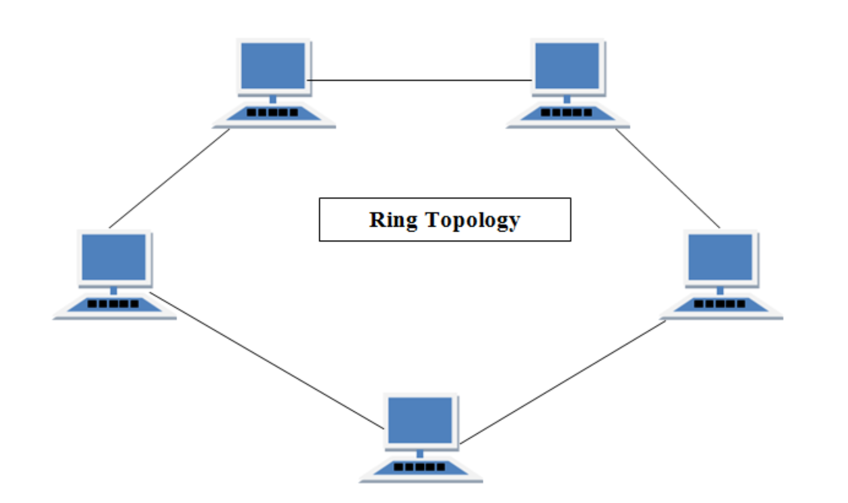
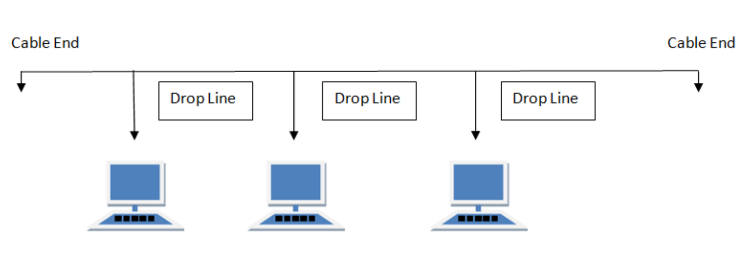
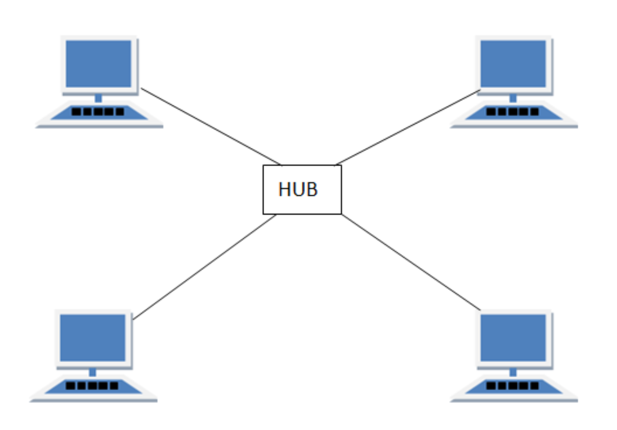
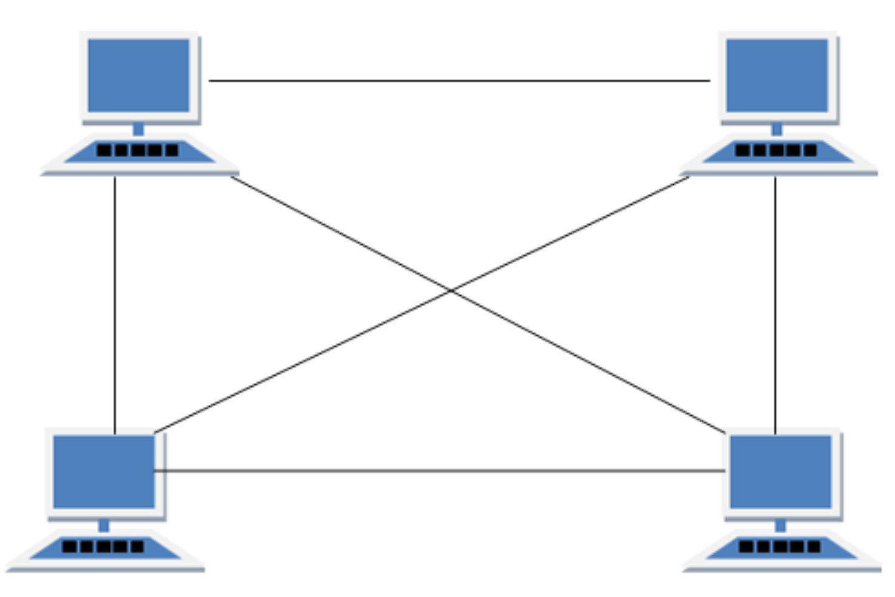
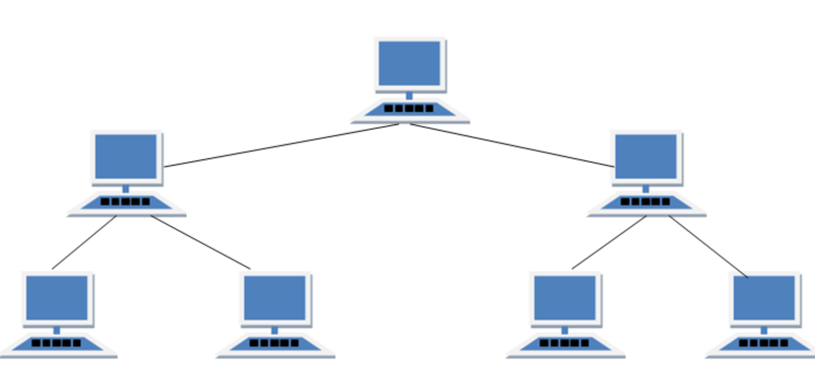
Topologies
Think domains, subnets …
Most networks today are hybrids
BUS
MESH
TREE
STAR

Slide 8
Network Architecture terms
Protocols
The communications architecture for sending/ receiving data over networks
Low level protocols:
TCP/ IP, Token Ring
Application Layer:
FTP, HTTP, SMTP, POP3, SMB, …
APIs are built on Layer 7 protocols
Layer 7 (Application)
Layer 6 (Presentation)
Layer 5 (Session)
Layer 4 (Transport)
Layer 3 (Network)
Layer 2 (Data Link)
Layer 1 (Physical)
OSI 7 Layer model
https://osi-model.com/

Slide 9
Network Implementations of the OSI Model
History of OSI:
https://spectrum.ieee.org/tech-history/cyberspace/osi-the-internet-that-wasnt
Tanenbaum, Computer Networks, 1981, p. 22

Slide 10
Impact on Software architecture
Distribution of components
  Each ‘network hop’ adds to delays
  Communications delays (network protocols)
  Processing delays (logic and data transformation per component)
  Dealing with firewalls and network segments
Management of components
  How are failures managed? (You have no control over a remote component)
API management
  What is the API? How is it structured? How is it controlled?
Protocols?
  How efficient is the protocol? Is encryption involved?

Slide 11
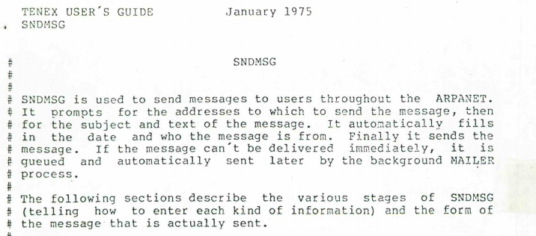
Simple Network applications
Some of the earliest network applications were Email and FTP
SNDMSG a precursor to SMTP.
Used FTP MAIL command to
transmit a message between
computers connected by the
ARPANET.
Evolved into SMTP.
Let’s see how SMTP works…
https://stacks.stanford.edu/file/druid:br059ts4875/br059ts4875.pdf

Slide 12
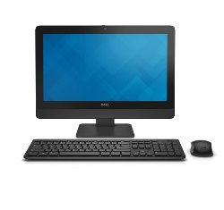


Email -- Send
The simple act of sending an email relies on the SMTP (Simple Mail Transfer Protocol) and multiple steps along the way get the message from you to the destination
When you click ‘Send’
The message is wrapped in the SMTP protocol
The message is encoded and sent to your local SMTP server
The recipient domain is extracted
The DNS server is located to find the receiving domain
The message is send to the domain
The Domain Server locates the receiving SMTP server
The email is stored on the receiving SMTP server
The process has many steps, and can fail in multiple places
  This is why mail servers may accept your email, but an hour later, you might get a ‘send’ failure
kalrabb@rit.edu
SMTP Server
DNS
kalrabb@rit.edu
Domain Server
Receiving SMTP Server
Pull email: POP or IMAP

Slide 13
Protocols: Text based
Basically, open a port, send commands
> telnet
> open mymailserver.smtp.com 25 //the port
> EHLO mydomain.com
> MAIL FROM: kalrabb@mydomain.com
> RCPT TO: sendto@theirdomain.net
> DATA <….>
https://docs.microsoft.com/en-us/Exchange/mail-flow/test-smtp-with-telnet?view=exchserver-2019

Slide 14
With RIT server
RITs mail relay for SMTP is smtp-server.rit.edu
Can use HELO or EHLO
Need to be within RIT network when using it
Only accepts RIT email senders (?)
Different SMTP servers have different rules for sequence of commands, authentication rules and controls around who can use them

Slide 15
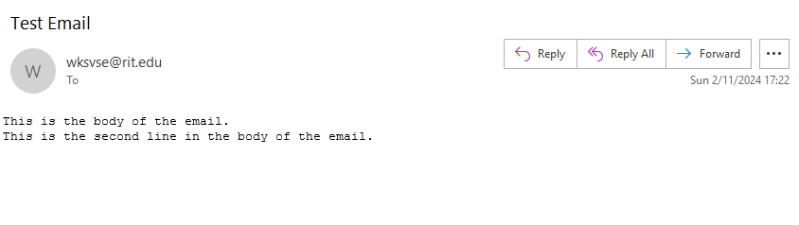
With smtp-server.rit.edu
$ telnet smtp-server.rit.edu 25
Trying 129.21.1.100...
Connected to smtp-server.rit.edu.
Escape character is '^]'.
220 *************************
HELO
250 smtp-server.rit.edu
MAIL FROM: wksvse@rit.edu
250 sender <wksvse@rit.edu> ok
RCPT TO: wksvse@rit.edu
250 recipient <wksvse@rit.edu> ok
DATA
354 go ahead
Subject: Test Email
This is the body of the email.
This is a second line in the body of the email.
.
250 ok: Message 147214628 accepted
QUIT
221 smtp-server.rit.edu
Connection closed by foreign host.
Notes:
mymail.rit.edu may be an alternative if students are having problems with smtp-server.rit.edu

Slide 16
Other notes
Email was (like most of the internet), first conceived with simple text data in mind.
This was soon found to be inadequate
“One of the notable limitations of RFC 821/822 based mail systems is the fact that they limit the contents of electronic mail messages to relatively short lines …” (from MIME RFC https://tools.ietf.org/html/rfc2045)
MIME (Multi-part Internet Mail Extensions) allows encoding non-textual data (e.g. binary) and large data sets in multiple segments)
This is what enables attachments and even though it was designed for email, this is extensively used in HTTP data/ file transfers!
Wherever you see ‘content-type’ … this is from MIME!
We will see more of this during the main Project

Slide 17
Exploring Network Protocols
Assignment:
- Using telnet command line, you will connect to and send email via SMTP
(use smtp-server.rit.edu)
- Using telnet command line, you will connect to and send a file via FTP (https://docs.microsoft.com/en-us/windows-server/administration/windows-commands/ftp#:~:text=The%20ftp%20command-line%20parameters%20are%20case-sensitive.%20This%20command,sub-environment%20in%20which%20you%20can%20use%20ftp%20commands.)
Using FTP to seappserver3.rit.edu, switch to the section_1 directory and upload a text file containing your smtp command history for sending an email. Use the following username/password combination:
  ftp_activity/ftp_activity_password

